Slide 1
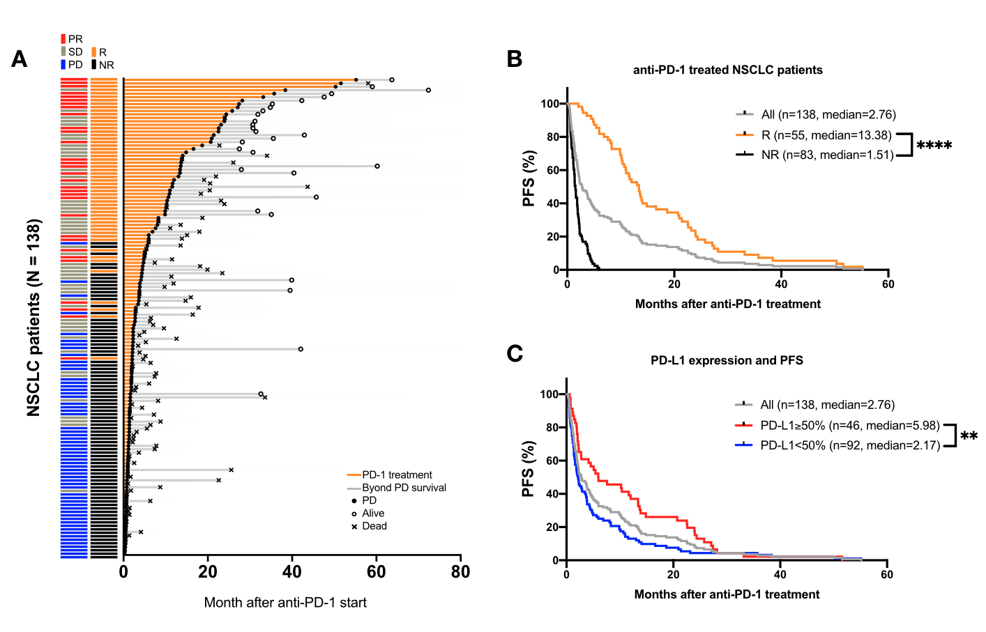
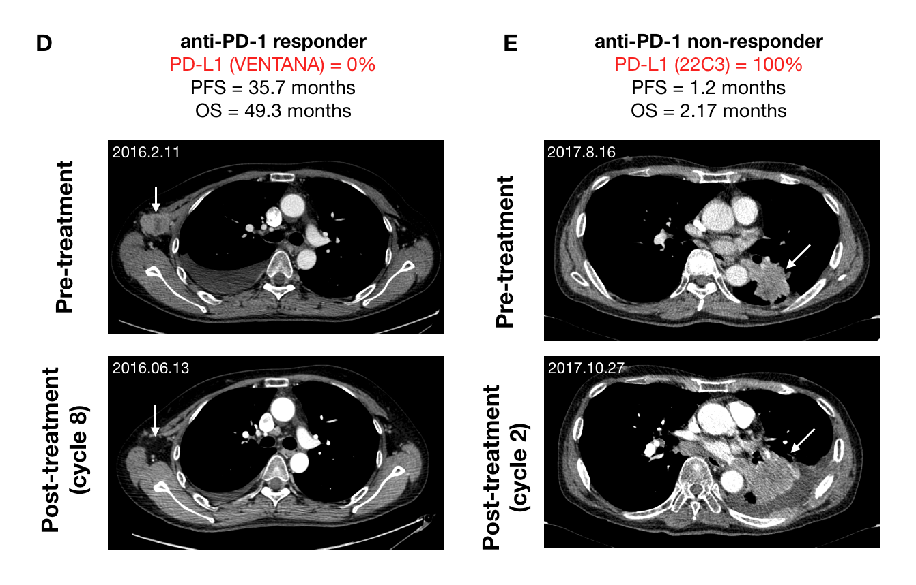
Figure 1. PD-L1 expression is not a promising predictive biomarker of anti-PD-1 therapy on NSCLC patients

Slide 2
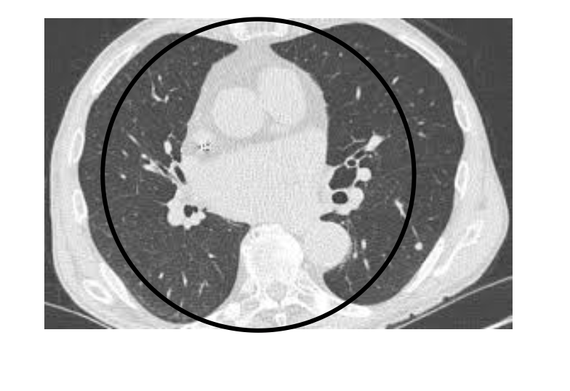

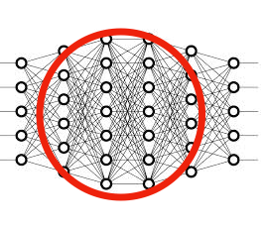

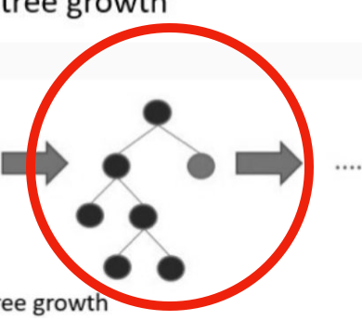
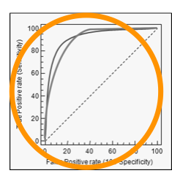

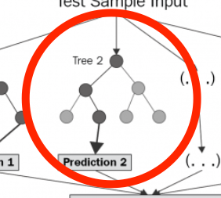
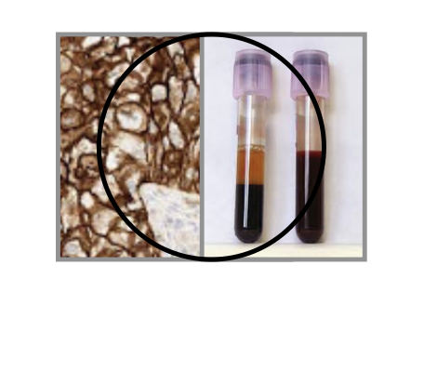
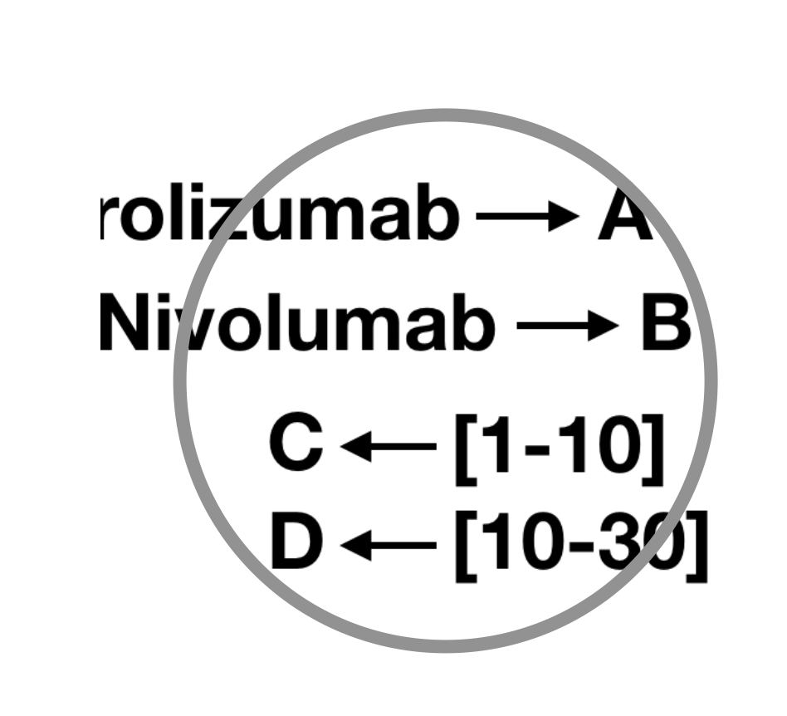
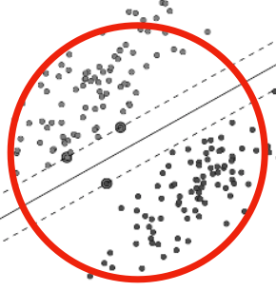
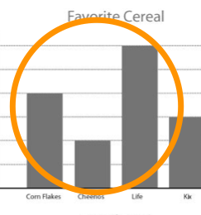
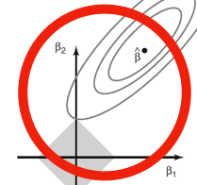

Figure 2. Dataset generation and application of machine learnings for prediction of anti-PD-1 responses in NSCLC patients
Discovery set
(n=138)
Validation set
(n=50)
Last follow up
2014.3
2018. 1
2018.12
2020.4
Data-
Sets
Feature
Selection
Pre-
processing
Discovery
dataset
MACHINE
LEARNING
Model-
Selection
Validation
dataset
Radiological
Feature
Normalization
Deep learning
Ontological
selection
LightGBM/
Xgboost
ROC curves
Random
Forest
Hematological/histological
Feature
Categorization
138 patients
18 features
SVM
50 patients
Asymmetry
features
removal
Cross validation
Ridge/Lasso
Regressions
Clinical
Feature
Outlier removal
Logistic
Regressions
FEATURE ENGINEERING
MACHINE LEARNING

Slide 3
Table 1. Types of features and references
No. | Feature name | Description | Clinical evidences | Ref.
1 | Certain non-measurable tumor lesions | Sum of positivity of malignant pleural effusion, carcinomatosis and multiple metastatic bone lesion | MPE as predictors of shorter PFS (HR: 1.52, 95% CI: 1.01-2.29; P = 0.043) of NIvolumab MPE was variable showing a significant correlation with OR of NIvolumab Uncommon metastases including peritoneum were associated worse survival with a hazard ratio (HR 1.29, 95% CI 1.09–1.52 p <0.01) Bone marrow metastasis occurs in lung adenocarcinoma patients with a poor prognosis Elevated NLR was associated with worse OS (HR for log(NLR)=3.64, 95% CI 1.78-7.46, p<0.001) and lower response rates (OR for log(NLR)=0.17, 95% CI 0.04-0.68, p=0.013).
2 | Neutrophil to lymphocyte ratio | Neutrophil count / lymphocyte count before immunotherapy | Pretreatment neutrophil-to-lymphocyte ratio (NLR) ≥5 was independently associated with inferior OS (median 5.5 vs. 8.4 months; HR 2.07, 95% CI 1.3-3.3; p=0.002) and inferior PFS (median 1.9 vs. 2.8 months; HR 1.43, 95% CI 1.02-2.0; p=0.04
3 | PD-L1 percent | PD-L1 expression levels in tumor cells determined by the percentage of stained cells in section | Pretreatment PD-L1 expression level correlates with better response but controversial.
4 | Immunotherapy type | Type of immunotherapy (ex. Nivolumab, Pembroluzumab) | Did not show any significant differences in the efficacy endpoints (ORR, PFS, OS)
5 | Smoking years | Number of cigarette packs per day x years | Prolonged the OS (HR, 0.69; 95% CI, 0.60–0.78) and PFS (HR, 0.55; 95% CI, 0.43–0.67; P = 0.027) in smoking patients
6 | Brain metastasis at baseline | Brain metastasis at baseline | The median progression-free survival times were 1.7 (95% confidence interval [CI]: 1.5–2.1) and 2.1 (95% CI: 1.9–2.5) months, respectively (p = 0.009).
7 | ECOG | European Cooperative Oncology Group (Performance status score) | Patients with a poor ECOG status might be less likely to benefit from IO
8 | Bone metastasis at baseline | Bone metastasis at baseline | Shorter progression free survival (PFS; non-squamous: 3.0 versus 4.0 months, p < 0.0001; squamous: 2.7 versus 5.2 months, p < 0.0001) and overall survival (OS; non-squamous: 7.4 versus 15.3 months, p < 0.0001; squamous: 5.0 versus 10.9 months, p < 0.0001).
9 | Number of metastatic sites | Number of metastatic sites | Poor PFS was independently associated with and high number of metastatic sites (p=0.007)
10 | Pathology | Pathology type (ex. adenocarcinoma, squamous) | Adenocarcinoma had significantly shorter PFS compared to patients with squamous carcinoma [median=3.7 (95%CI=2.6-4.8) months vs. 6.8(95% CI 4.8-8.7) months, p=0.013
11 | Previous line of Therapy | Previous line of therapy | Prolonged the OS (HR, 0.56; 95% CI, 0.37–0.85, p<0.01) in line<=2 patient
12 | Liver metastasis at baseline | Liver metastasis at baseline | Median PFS was significantly longer in patients without liver metastasis than in patients with liver metastasis at baseline imaging for nivolumab (100 versus 42 days [p = 0.0002, log-rank test])
13 | Presence of driver oncogene | Presence of driver oncogenes (EGFR, ALK or ROS1) | Presence of driver oncogenes are associated with poor prognosis
14 | Gender | Gender | The results were consistent with our main findings, showing a significantly higher benefit in men compared with women (P =0·007).
15 | Adrenal gland metastasis at baseline | Adrenal gland metastasis at baseline
16 | Other metastasis at baseline | Other metastasis at baseline
17 | Ipsilateral lung metastasis at baseline | Ipsilateral lung metastasis at baseline | Lung (HR: 1.57, 95.0% CI: 1.14-2.16; p < 0.01) independently correlated with a significantly shorter progression-free survival in nivolumab-treated patients.
18 | Contralateral lung metastasis at baseline | Contralateral lung metastasis at baseline | Lung (HR: 1.57, 95.0% CI: 1.14-2.16; p < 0.01) independently correlated with a significantly shorter progression-free survival in nivolumab-treated patients.

Slide 4
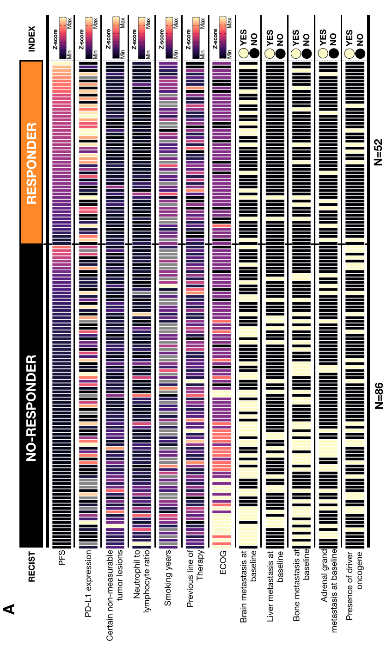
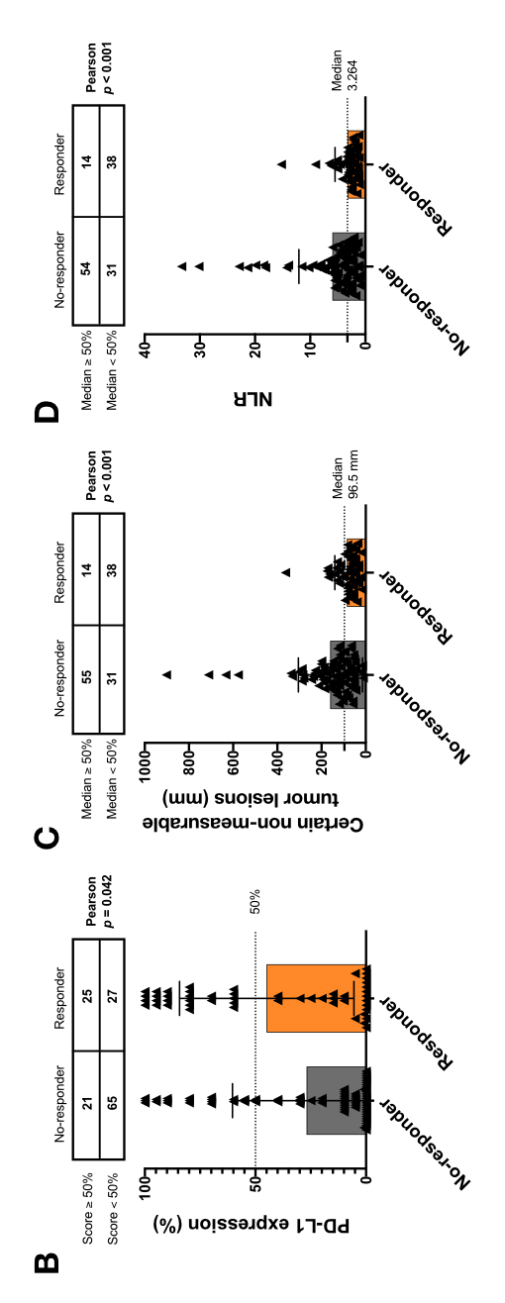
Figure 3. Clinical features and anti-PD-1 responses

Slide 5
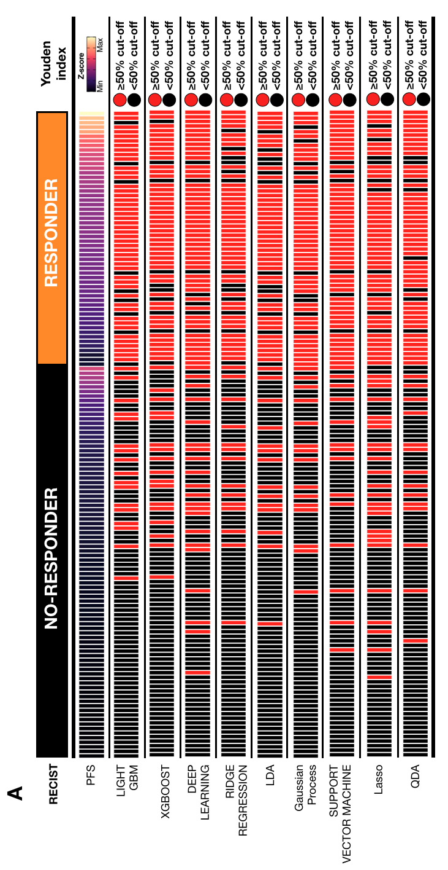
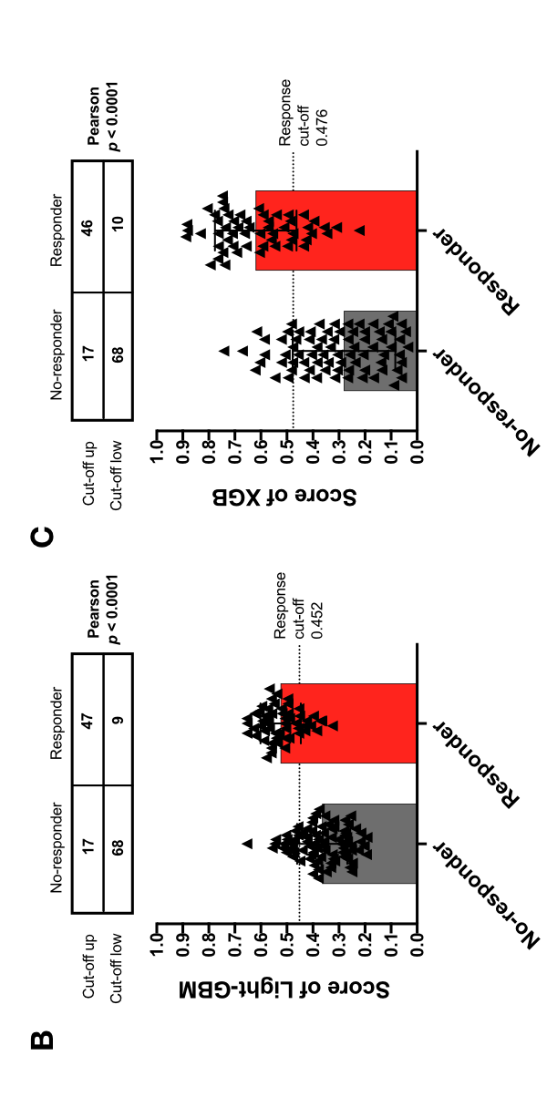
Figure 4. Machine learning based prediction of
anti-PD-1 responder

Slide 6
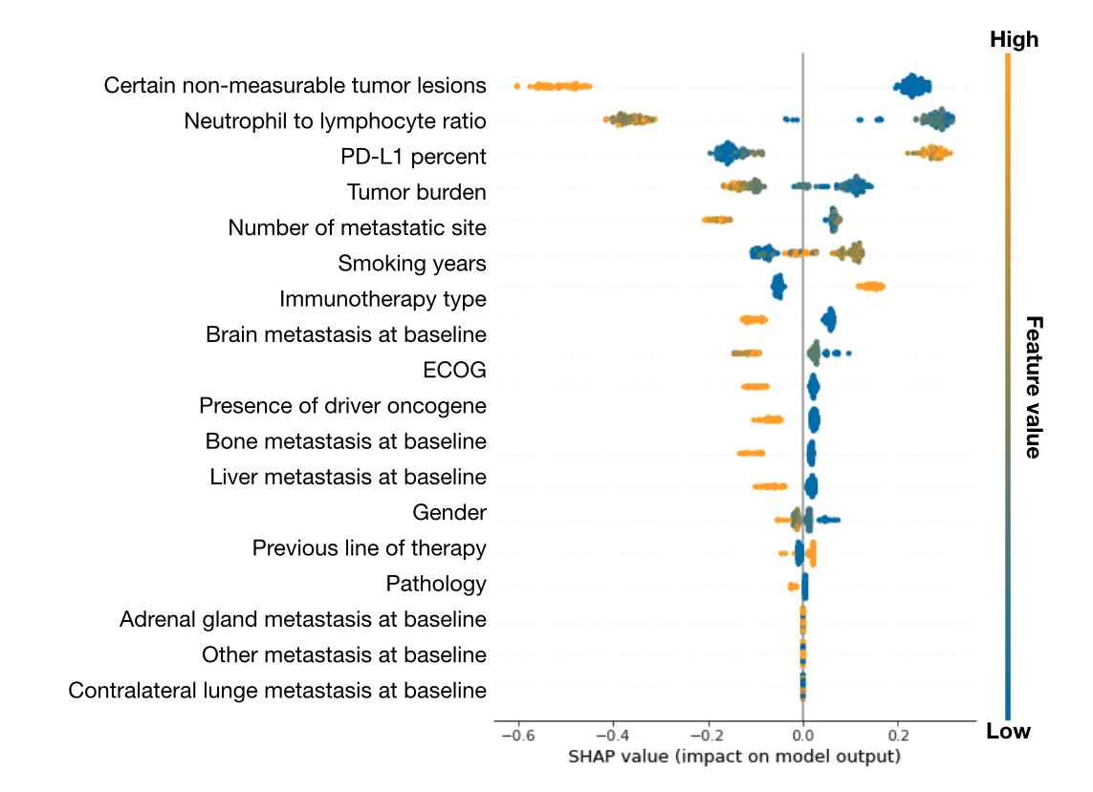
C
Figure 5. Shap-value and feature interaction score in LightGBM based prediction
A
B

Slide 7
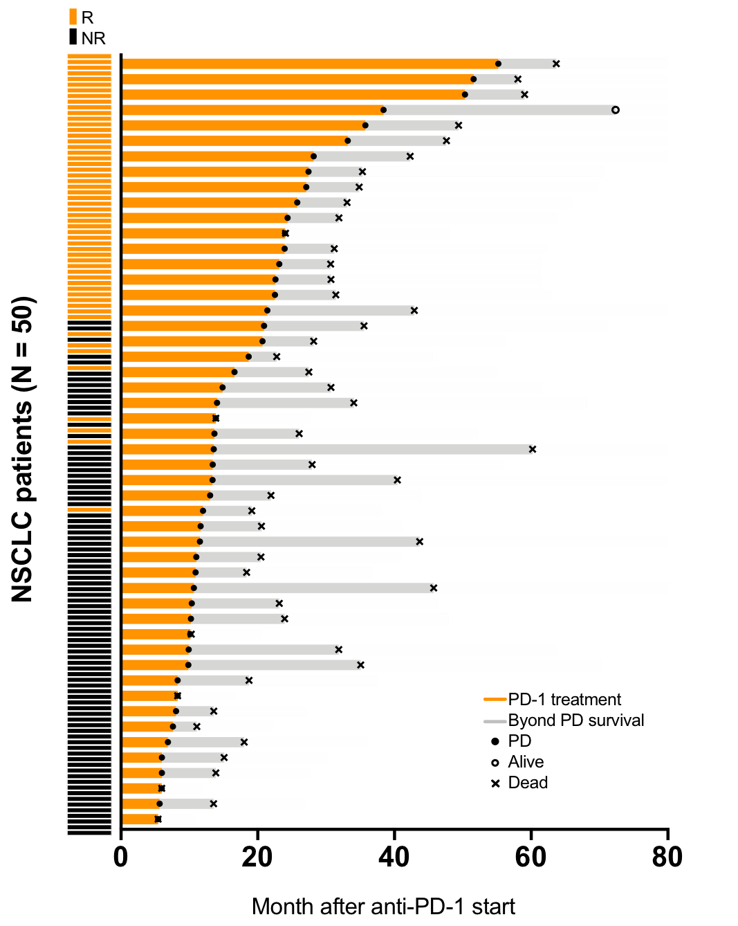
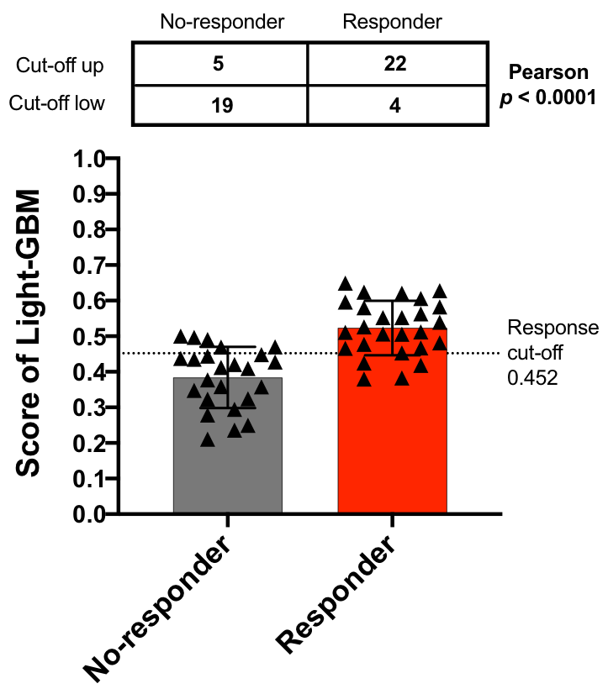
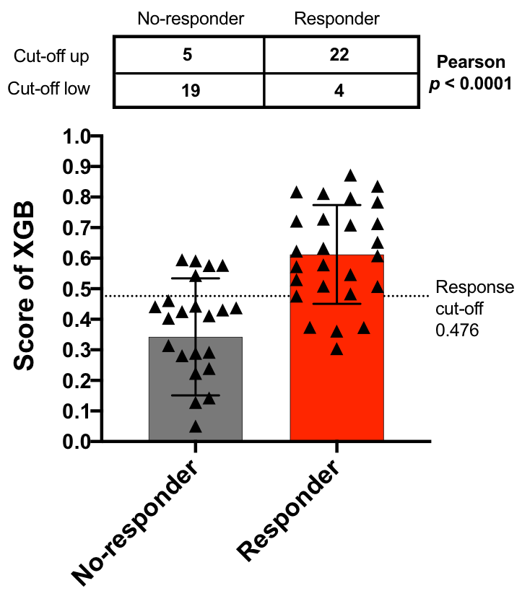
Figure 6. Validation of machine learning based prediction algorithm for
anti-PD-1 treated NSCLC patients
A
B
C

Slide 8
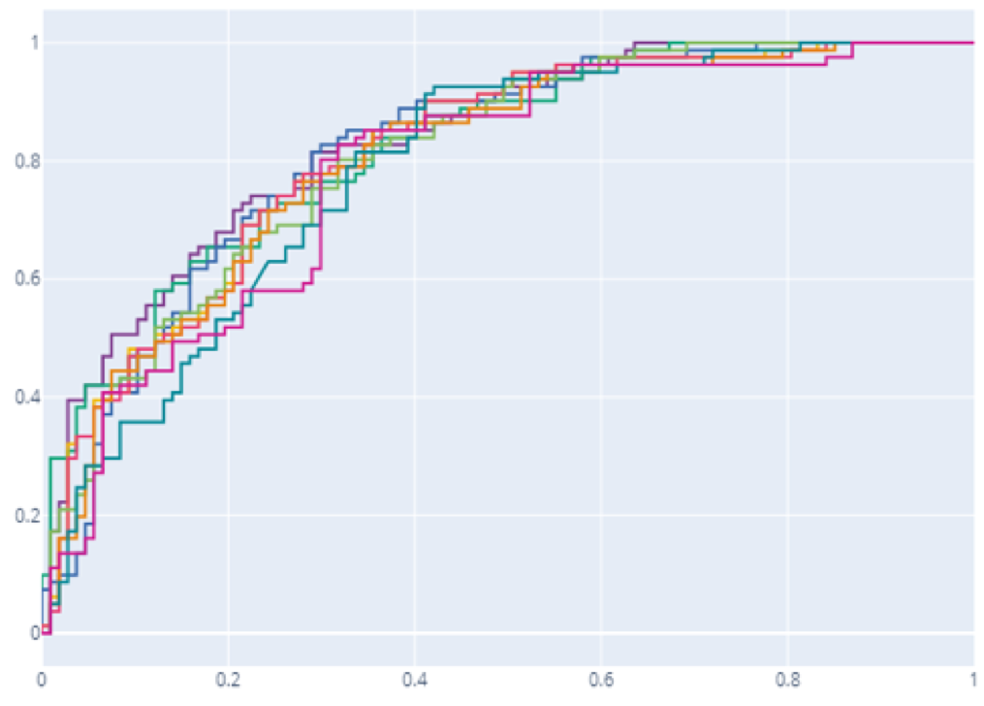
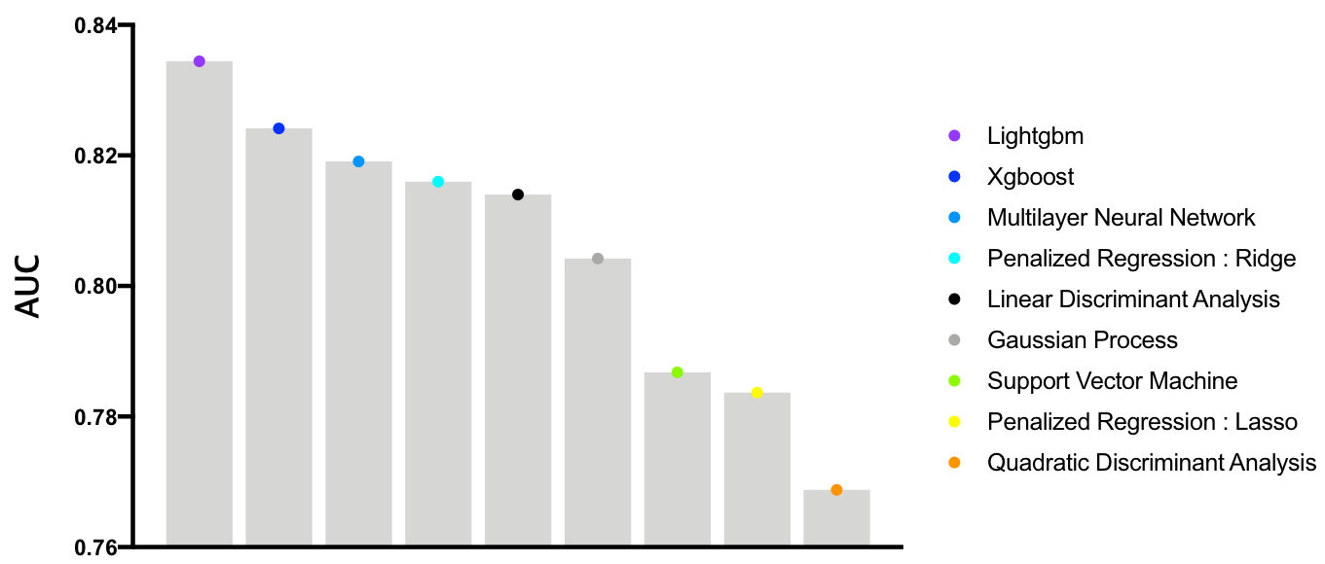
Supplementary Figure S1. Performance tests between variable machine learning algorithms
A
True positive rate
B
False positive rate

Slide 9
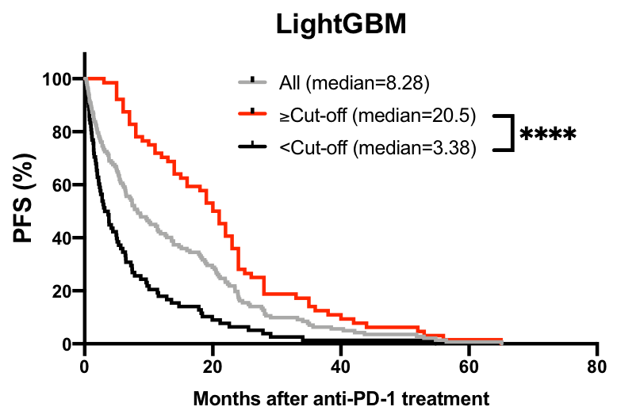
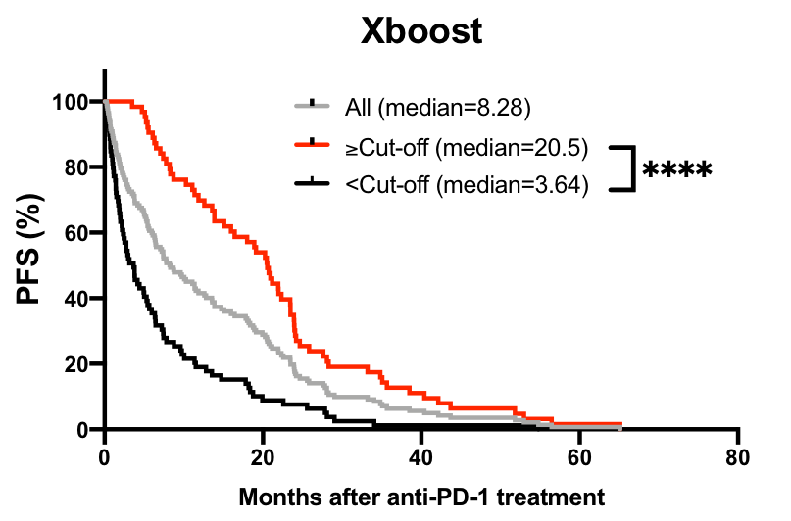
Supplementary Figure S2. Kaplan meier plot of anti-PD-1 treated NSCLC patients with LightGBM and Xboost model based prediction

Slide 10
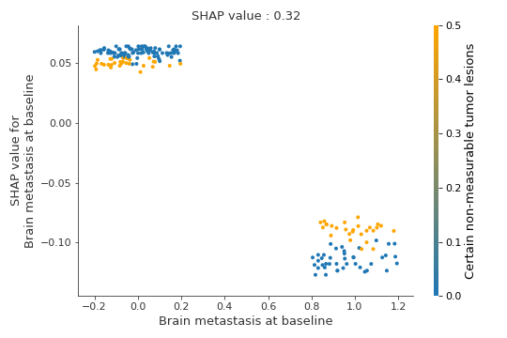
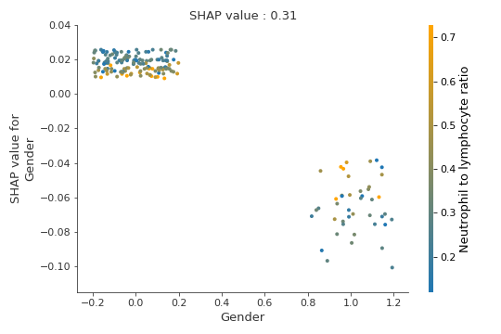
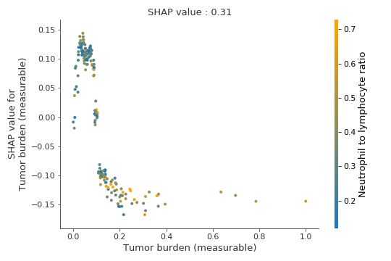
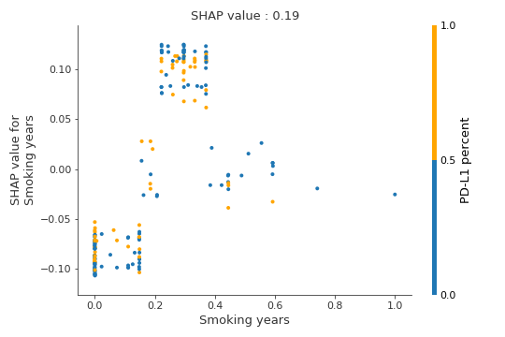
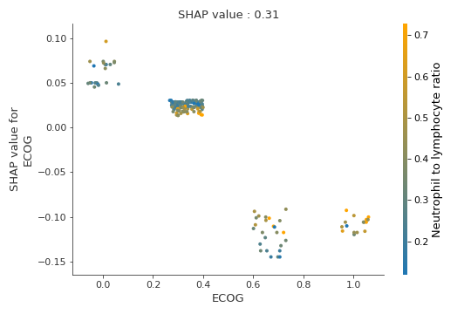
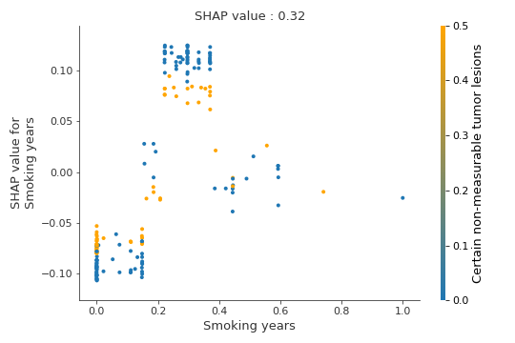
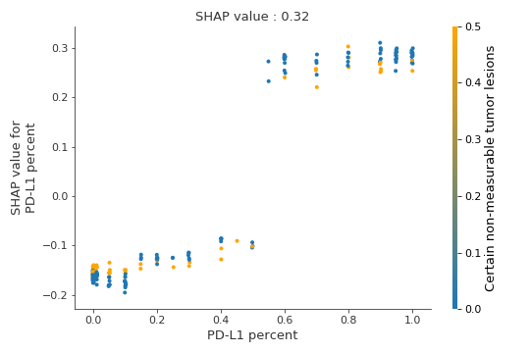
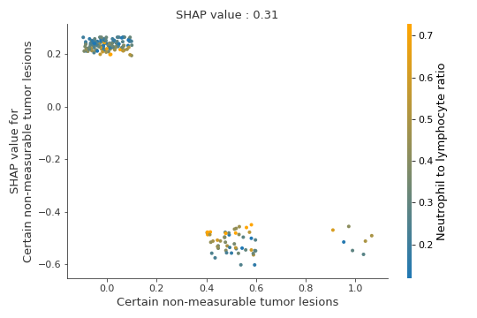
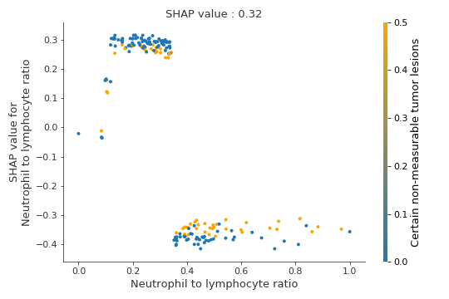
Supplementary Figure S3. Shap-value and feature interaction score

Slide 11
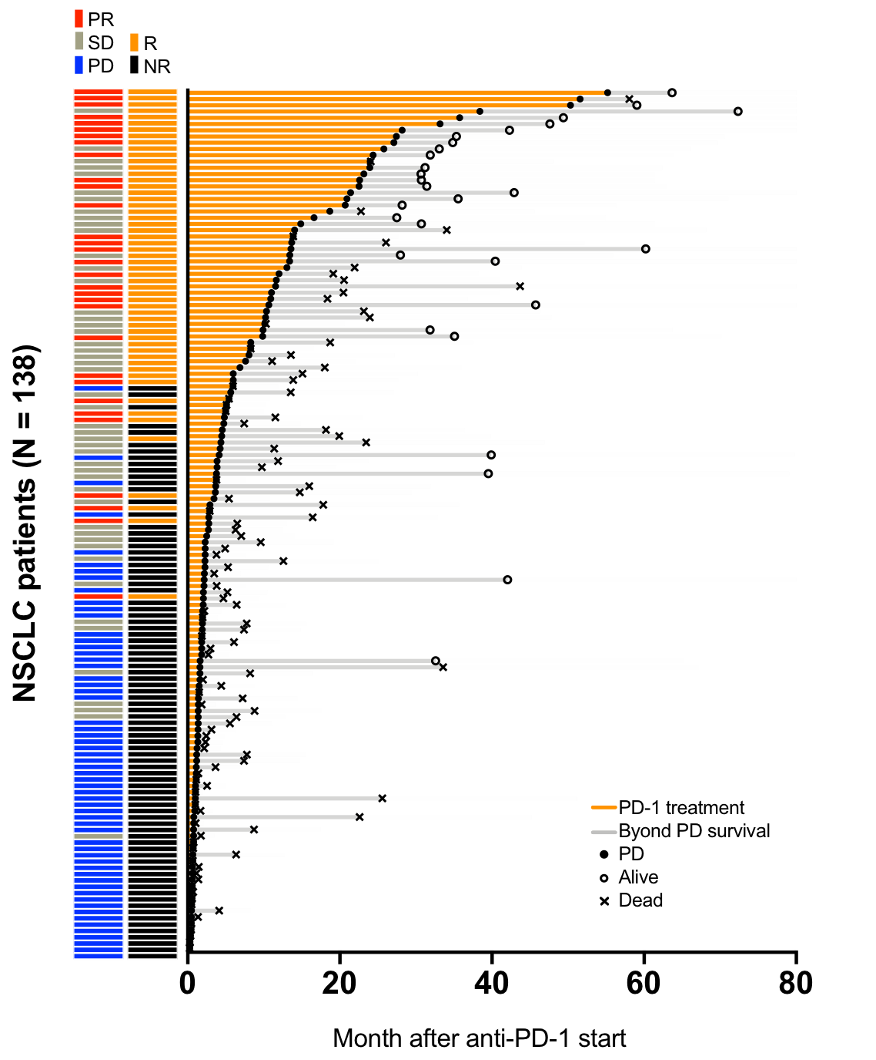
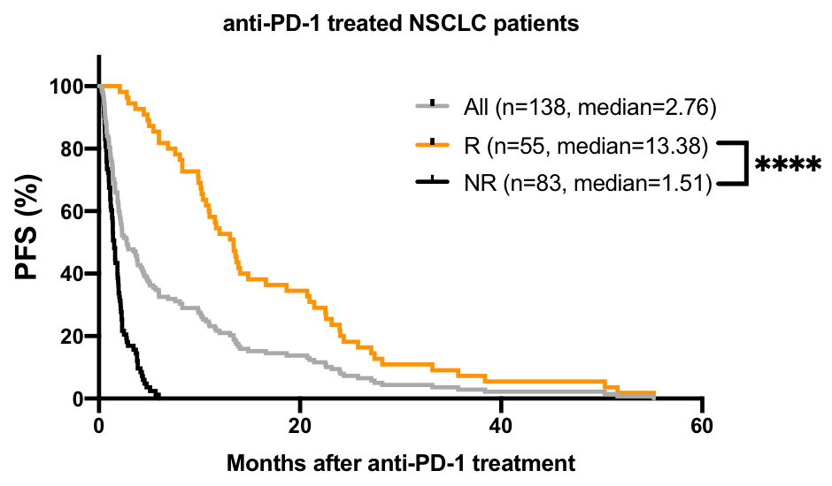
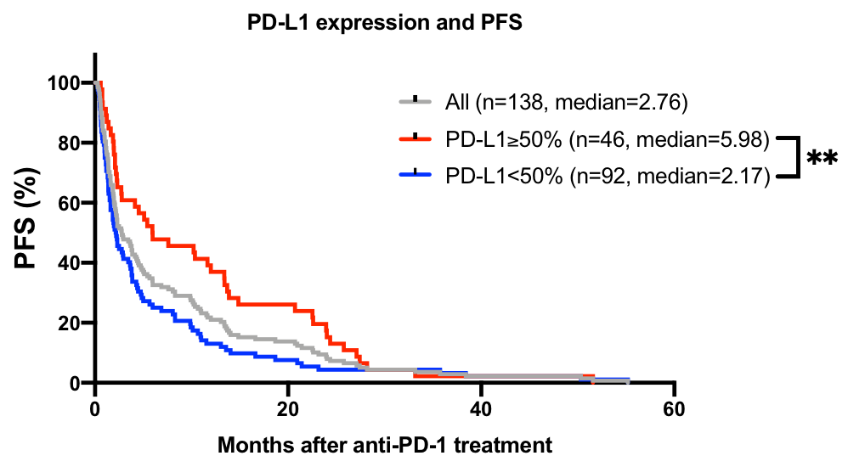
Figure 1A-D. PD-L1 expression is not a promising predictive biomarker of anti-PD-1 therapy on NSCLC patients
A
B
C

Slide 12
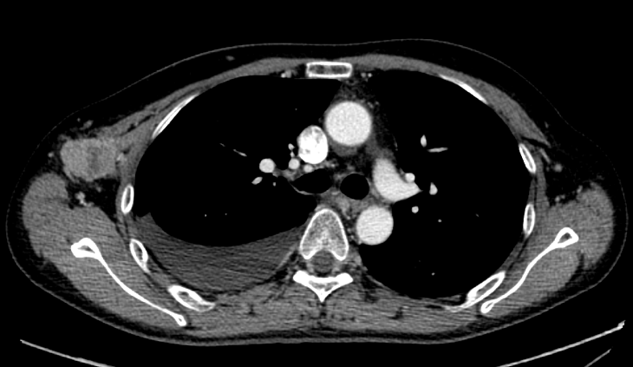
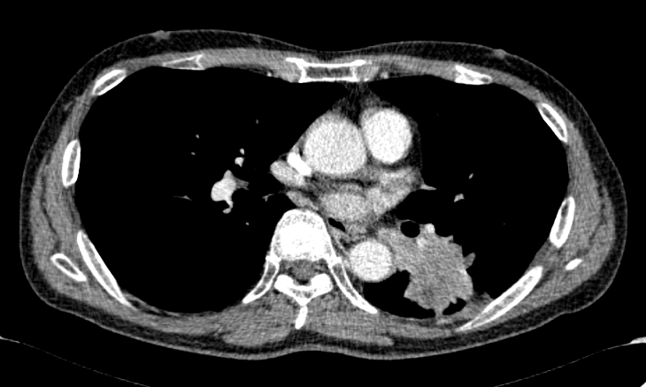
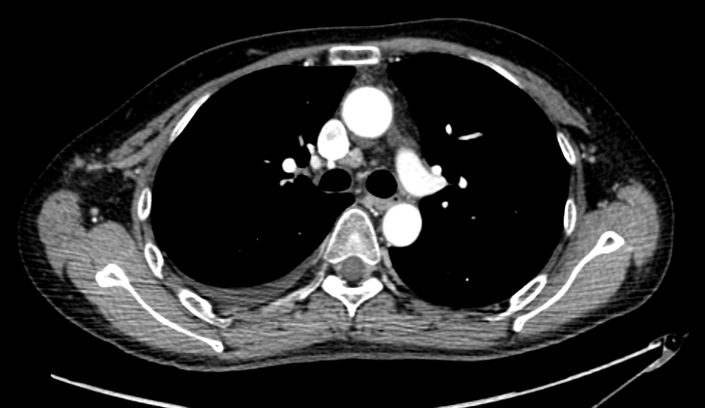
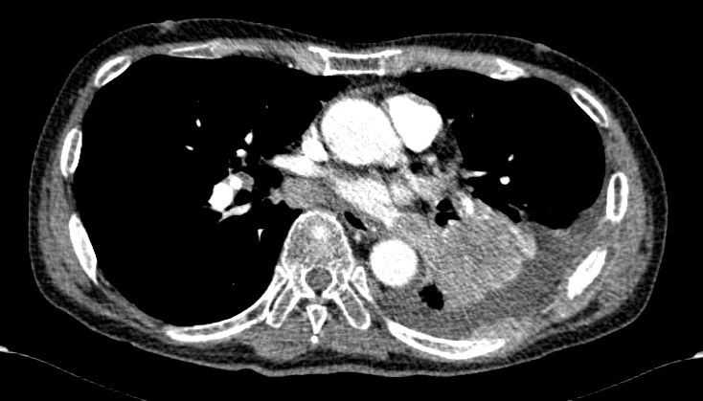
Figure 1E-F. PD-L1 expression is not a promising predictive biomarker of anti-PD-1 therapy on NSCLC patients
D
anti-PD-1 responder
PD-L1 (VENTANA) = 0%
PFS = 35.7 months
OS = 49.3 months
E
anti-PD-1 non-responder
PD-L1 (22C3) = 100%
PFS = 1.2 months
OS = 2.17 months
2016.2.11
2017.8.16
Pre-treatment
Pre-treatment
2016.06.13
2017.10.27
Post-treatment
(cycle 8)
Post-treatment
(cycle 2)

Slide 13
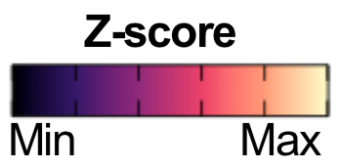
Figure 3A. Landscape of 21 features and anti-PD-1 responses
A
RECIST
NO-RESPONDER
RESPONDER
INDEX
PFS
PD-L1 expression
Certain non-measurable tumor lesions
Neutrophil to lymphocyte ratio
Smoking years
Previous line of Therapy
ECOG
Brain metastasis at baseline
YES
NO
Liver metastasis at baseline
YES
NO
Bone metastasis at baseline
YES
NO
Adrenal grand metastasis at baseline
YES
NO
Presence of driver oncogene
YES
NO
N=86
N=52

Slide 14
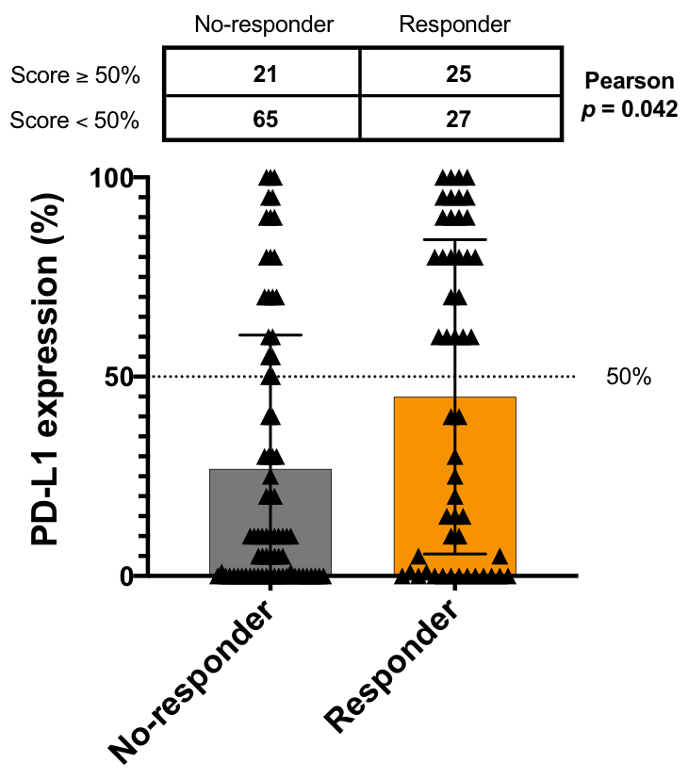
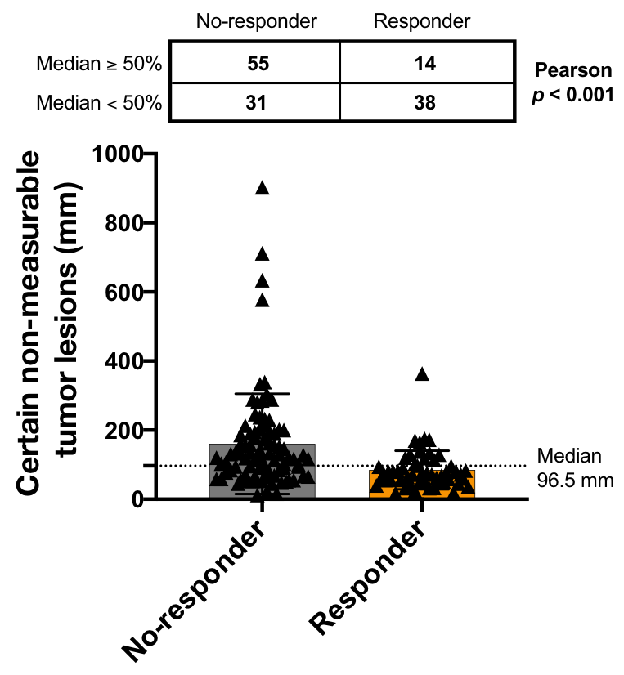
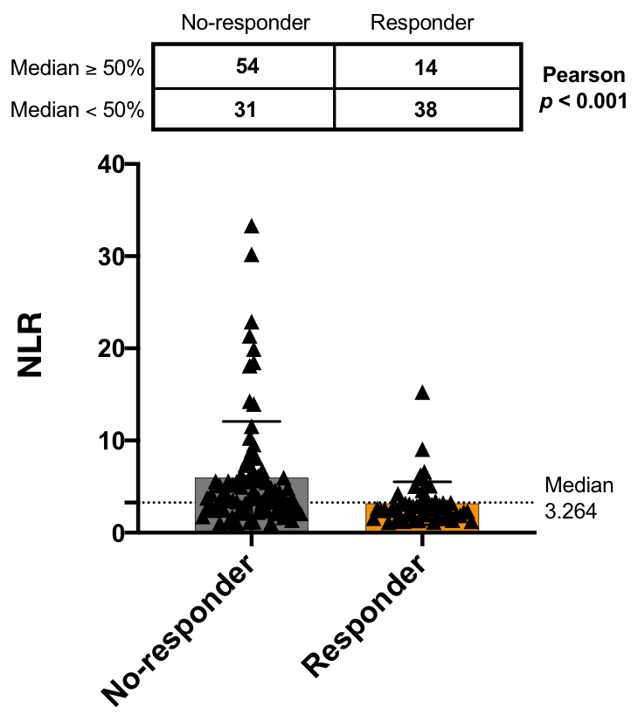
Figure 3A. Landscape of 21 features and anti-PD-1 responses
B
C
D

Slide 15
Figure 4A. Performance tests between variable machine learning algorithms
A
RECIST
NO-RESPONDER
RESPONDER
Youden
index
PFS
LIGHT
GBM
≥50% cut-off
<50% cut-off
XGBOOST
≥50% cut-off
<50% cut-off
DEEP
LEARNING
≥50% cut-off
<50% cut-off
RIDGE
REGRESSION
≥50% cut-off
<50% cut-off
LDA
≥50% cut-off
<50% cut-off
Gaussian
Process
≥50% cut-off
<50% cut-off
SUPPORT
VECTOR MACHINE
≥50% cut-off
<50% cut-off
Lasso
≥50% cut-off
<50% cut-off
QDA
≥50% cut-off
<50% cut-off

Slide 16
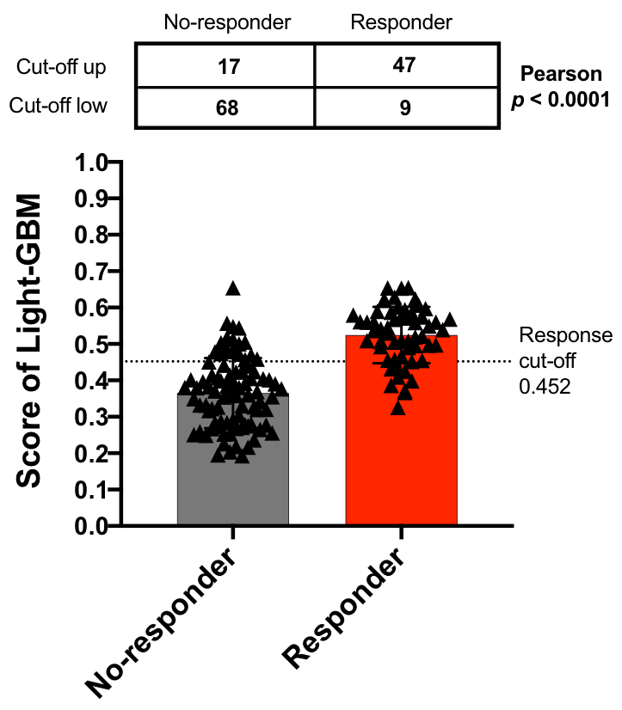
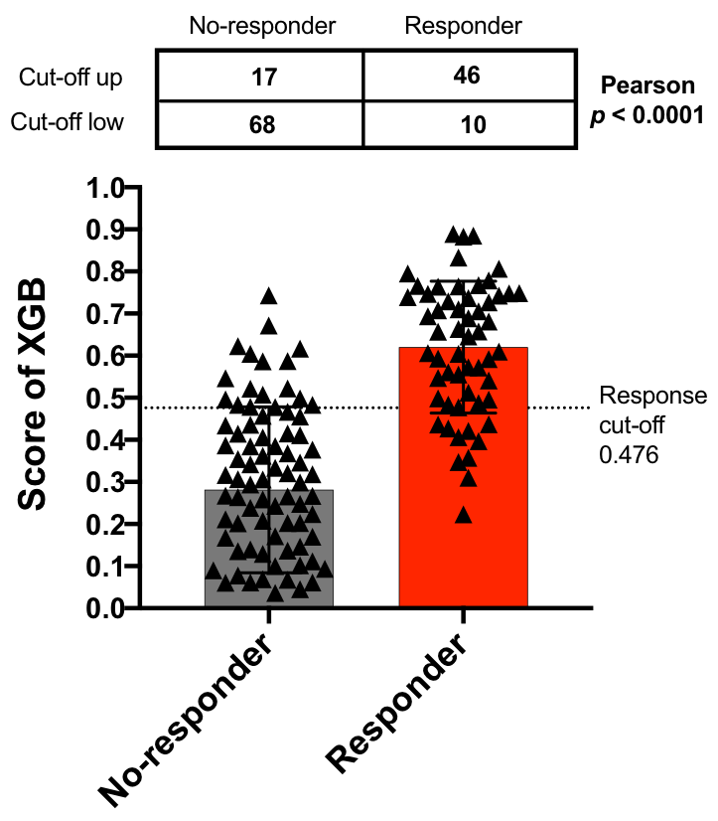
Figure 4B. Performance tests between variable machine learning algorithms
B
C

